Slide 1
“ACT on Drugs”
Matrix-based
FUNCTIONAL CONTEXTUAL PHARMACOLOGY collaborative workshop

Slide 2
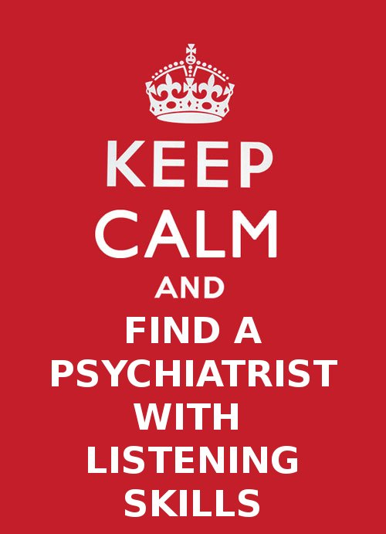
FUNCTIONAL
CONTEXTUAL
PSYCHIATRIST

Slide 3
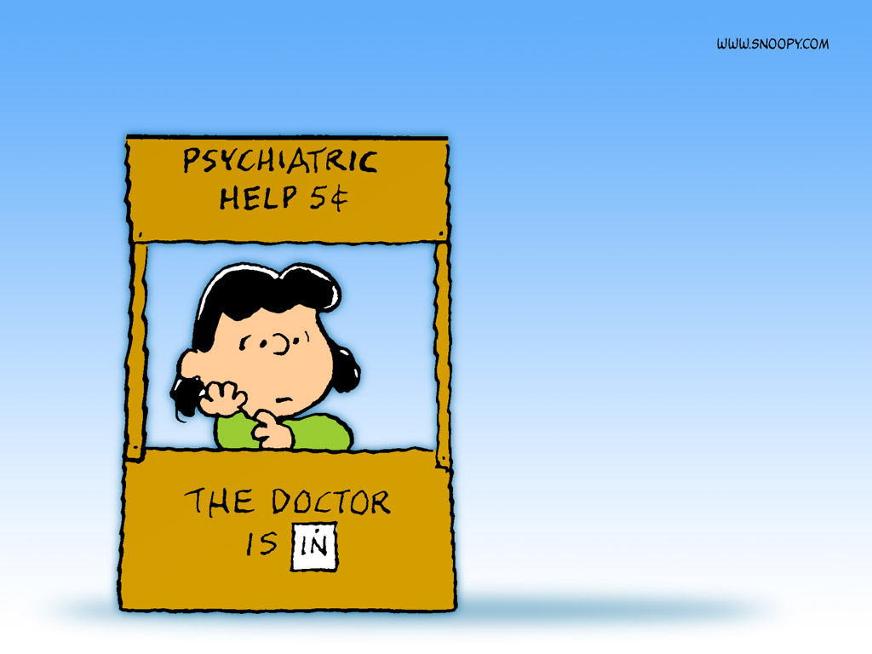
ACT on Drugs
Functional Contextual Pharmacology
Dr Robert Purssey MBBS FRANZCP
Functional Contextual Psychiatrist ☺
Clinical Senior Lecturer, Uni of Qld
Brisbane ACT Centre, Queensland

Slide 4
MOVING TOWARDS WORKABLE MEDICATION USE - TOGETHER
What is important to you and your clients? How can medication knowledge and use might be helpful?
What medication-related issues get in the way for you and them?
What do you and your clients do to move Away from these medication-related issues?
Can Functional Contextual Pharmacology help?
What can we and our clients do to move Toward those things important to us and them? How can we use medication knowledge and use to help?
Notes:
For clinicians, these are perhaps the most immediately useful applications of this material.

Slide 5
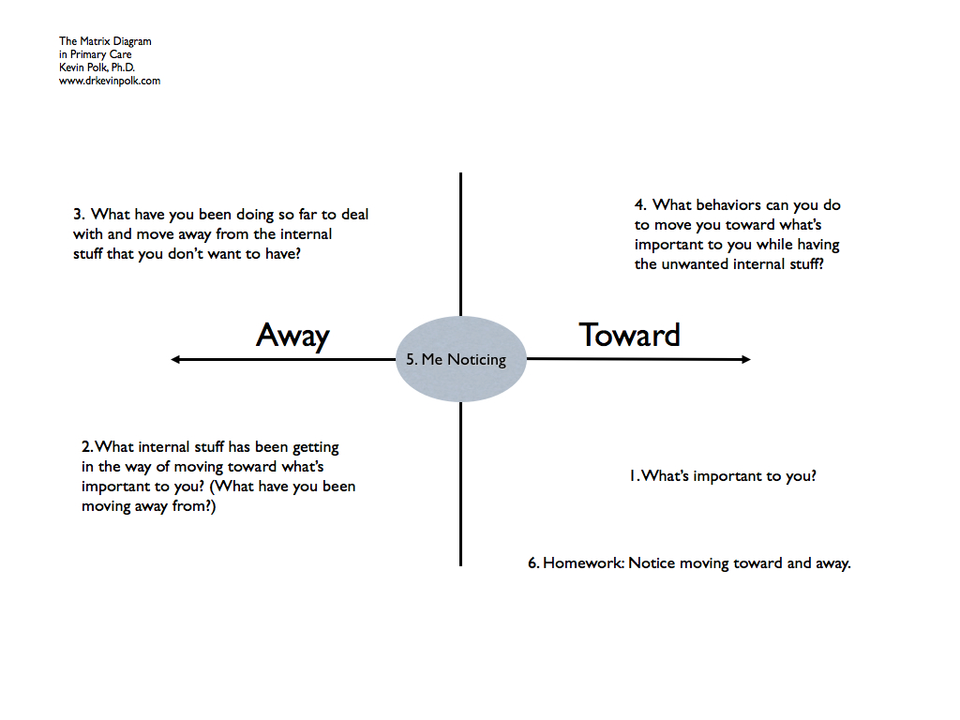

Slide 6
1. What is important to you and your clients? → in relation to medication usage
Live more fully Quiet the mind Respect autonomy Promote approach Understand client’s relationships with medications Functions of being ON medications Maintain relationships Find workable language Engage cognitively Solid knowledge about meds When to use meds How to get the best information | Develop a flexible mind as a therapist Defuse from medico therapist roles Develop FC Pharma knowledge base Systemic change Empowering Fun, sex, playfulness Recreation Informed consent Intimate relationships Friends and family effects Improving agency Cost effectiveness of medications in relation to behavioral interventions

Slide 7
2. What medication-related stuff gets in the way for you and them?
Marketing, pharma misinformation Cost, i.e. meds may seem cheaper to patients than therapy Stigma (self, social) Shame Nature of evidence we’re given Fear (clinicians and patients) Guidelines – carefully crafted Guilt Authority effect Side-effects Overmedication / pill burden | Causal stories External locus of control Prescribers treating own anxiety Evidence BIASED medicine Chronicity Medico-legal implications, civil Military patients on meds – effects Counterpliance to marketing “I can’t stop taking” Addiction / dependence Weight gain, diabetes Movement disorders

Slide 8
3. What do you and your clients do to move Away from these medication-related issues?
“It’s too hard!” Indiscriminate learning about medications refer on, “not my problem” set boundaries rigidly “they must deserve it” decline referrals chicken out self-doubt drink alcohol (self medicate) take holidays go quiet – can’t discuss out of role, keep my head down | retire distance from the client argue rant – lose client along the way coerce talk technical right/wrong answers overanalyse blame the system prescribe more/prescribe less confuse clients, oneself “It’s beyond my expertise” Ignore / forget meds issues

Slide 9
MOVING TOWARDS WORKABLE MEDICATION USE - TOGETHER
What is important to you and your clients? How can medication knowledge and use might be helpful?
What medication-related issues get in the way for you and them?
What do you and your clients do to move Away from these medication-related issues?
Can Functional Contextual Pharmacology help?
What can we and our clients do to move Toward those things important to us and them? How can we use medication knowledge and use to help?
Notes:
For clinicians, these are perhaps the most immediately useful applications of this material.
9

Slide 10
Functional Contextual Pharmacology
CBS - Seamlessly consistent with ACT
Functionally informed medication use
Enabling workable, wise medication use
Things that you’re liable
To read in the (psychiatric) bible
Ain’t necessarily so…

Slide 11
ACT on Drugs 2011 - the theory in detail
Functional Contextual Pharmacology
3 hour detailed workshop, contrasting with the mainstream
ANZACT 2011: "ACT on Drugs: Functional Contextual Pharmacology“
First part - http://mediasite.qut.edu.au/mediasite/Viewer/?peid=f5a7d1a8-690a-4c7d-933e-f327e102c1a5
Second part - http://mediasite.qut.edu.au/mediasite/Viewer/?peid=93917b14-7588-4e98-acc9-9d43a5afdc75
ANZACT 2011: "Functional Contextualism- History, and FC Neuroscience" –this lecture gives detailed philosophy of science background to the above - see also chapter 4 of Advances in RFT book http://mediasite.qut.edu.au/mediasite/Viewer/?peid=3dbc2eb2-b12a-4d66-9ef6-30d1102c77e2

Slide 12
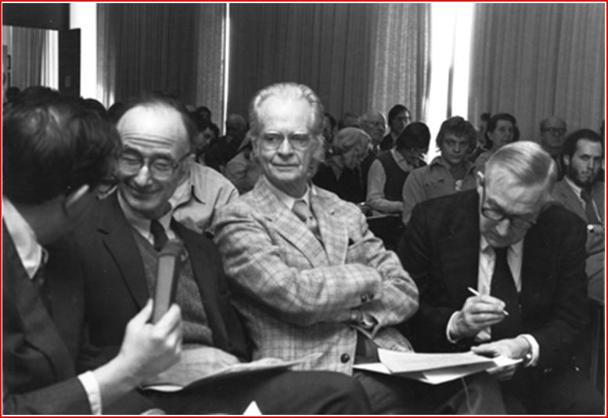
Behavioral Pharmacology – 1950’s
J. R. Pappenheimer, B. F. Skinner, and P. B. Dews
Notes:
I find this picture quite inspirational, as it represents the sort of confluence of rigorous, seminal science at Harvard University in the 1950’s.
B.F. Skinner is well known to all as the psychological scientist whose astonishing radical behaviorism forms the foundations of modern contextual behavioral science – CBS, RFT, ACT.
J.R. Pappenheimer was a physiologist at Harvard who discovered, intensively researched and published the basis for the ubiquitous key physiological phenomenon of osmosis, eg Pappenheimer, J. R. et al. Filtration, diffusion and molecular sieving through peripheral capillary membranes. Am. J. Physiol. 167: 13-46, 1951
P.B Dews will, I hope, become well known to you all as the father of behavioral pharmacology – and here is a nice account of his arrival at Harvard, and his connection to Skinner…
Dews was hired to the post of Instructor in Pharmacology at Harvard Medical School in January 1953 by Professor Otto Krayer, and spent the remainder of his academic career at Harvard. Krayer told Dews to call on B. F. Skinner in the Department of Psychology at Harvard University, who had told Krayer that he (Skinner) had techniques that would be useful in pharmacology.(!!☺!!) The results of that meeting were colorfully recounted by Dews at a meeting of the European Behavioural Pharmacology Society (Dews, 1997). Dews met briefly with Skinner, and was then shown around the laboratory by Skinner's younger associate, C. B. Ferster. As Dews tells the story, he immediately felt at home in the laboratory; he sensed that he had found what was needed to objectively study the behavioral effects of drugs. The functional character of the laboratory was more like a physiology or pharmacology laboratory than what he had expected from a psychology laboratory. The likely leading contribution to his comfort with the laboratory environment was the kymograph-like tracings of the cumulative recorders drawing records of behavior occurring in time, and in systematic relation to environmental events.
Dews and Ferster immediately launched studies on the behavioral effects of drugs, some of which were published in Ferster and Skinner's compendium, Schedules of Reinforcement (Ferster and Skinner, 1957)…
Finally for historical viewpoint linking the above, pointing to just how important these 3 scientists remain, here is a very cool and telling quotation from PB Dews 1963:
In emphasizing the importance of schedules it is not intended to imply that all of psychology should be reduced to a study of them. An influence can be all pervading without being all embracing. No one would maintain that all mechanisms of physiology can be reduced to the laws of osmosis; yet osmotic phenomena are ubiquitous in physiology; whenever they can operate, they do; and the student of any physiological mechanism ignores osmosis at his peril. Similarly, it is suggested that schedule influences operate generally in psychology; that when these influences can operate, they will; and that a student of any problem in psychology - whether it be motivation, generalization, discrimination or the functions of the frontal lobes - ignores the consequences of the precise scheduling arrangements of his experiments at his peril. (pp 8-9)
Dews' (1963) comparison of reinforcement schedules in behavioral pharmacology to osmosis in physiology remains as valid and relevant today as it was when he originally made the observation. Although we cannot explain all behavior, or all effects of drugs on behavior by reference to the environmental contingencies of reinforcement, whenever contingencies of reinforcement can influence behavior they will.
Dews PB (1963) Behavioral effects of drugs. In: Farber SM, Wilson RHL (eds) Conflict and creativity, control of the mind, part 2. McGraw-Hill, New York
BY 1955 DEWS HAD PUBLISHED THE FIRST AND STILL CRITICALLY IMPORTANT EXPERIMENTAL FINDING FROM THE HARVARD PSYCHOBIOLOGY LABORATORY (see also following slides ) → I’ve highlighted critically important details…
Dews, P.B. Studies on behavior. I.
Differential sensitivity to pentobarbital of pecking performance in pigeons depending on the schedule of reward. 1955 J Pharmacol Exp Ther 138:393-401
In this seminal paper and in the several that followed, Dews and his colleagues applied techniques and concepts adapted from the behavioral psychology of B.F. Skinner to develop a functional analysis of the behavioral effects of drugs.
Rather than appealing to hypothetical constructs representing internal psychological processes inferred from and having meaning beyond the behavioral observations, Skinner and colleagues examined the functional relationships between the organisms' behavior and the environment. The methods and analyses of behavior utilized by Skinner emphasized these relationships between behavior and, in particular, its consequences. These relationships between behavior and its consequences were referred to as schedules of reinforcement (Ferster and Skinner 1957).
The exclusion of hypothetical constructs based on their lack of reducibility to functional relations between behavior and its environmental determinants is arguably the most important distinction between the formulations of Skinner and those of the learning theorists of his day. Hypothetical constructs are of two types, those that are potentially verifiable, e.g. events taking place in the CNS that relate to behavior, and those that are metaphorical, e.g. those that are exclusively heuristic, "explaining" behavior with models that cannot be seriously believed because of other knowledge (MacCorquodale and Meehl 1948).
The former (potentially verifiable) certainly have their place in a science that relates behavior to neurobiology. However, as noted by Skinner, this type of construct is not necessary for a pure science of behavior (i.e. one that deals exclusively with functional relations between behavior and its environmental determinants), and the science of behavior can be complete without these. Metaphorical constructs, on the other hand, can have a heuristic benefit, but they also have the potential of generating circular explanations whereby the causes of behavior are "explained" by the constructs from which they are inferred. Most problematic is that an approach employing constructs directs attention away from the actual determinants of behavior.
Much of the above account is from the truly excellent article (which best covers this material of anything I’ve yet read):
McMillan, D.E. and Katz, J.L. Continuing implications of the early evidence against the drive-reduction hypothesis of the behavioral effects of drugs. Psychopharmacology 2002
Wherein these important references (per above):
Ferster, C.B. and Skinner, B.F. Schedules of Reinforcement . Appleton-Century-Crofts, New York (1957).
MacCorquodale K, Meehl PE (1948) On a distinction between hypothetical constructs and intervening variables. Psychol Rev 55:95-107
Oh, and they all 3 had fun, enjoyed teaching, and wrote significantly about their lives outside Academe, i.e. We knew about various aspects of their controlling varialbles ☺

Slide 13
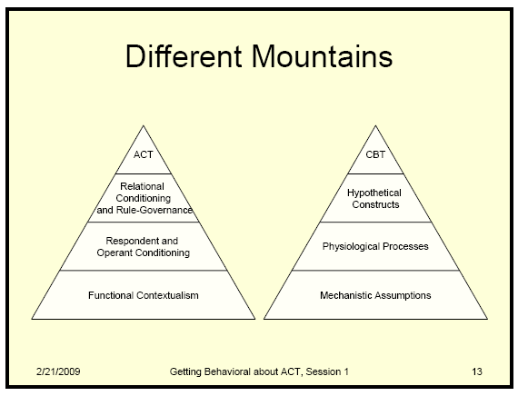
FC Therapies & Mechanist Rx’s
Functional
Contextual
Pharmacology
Mechanist
Dualist / Mentalist Psychopharmacology
Notes:
Credit to Chad Drake “getting behavioral about ACT” lectures for diagram

Slide 14

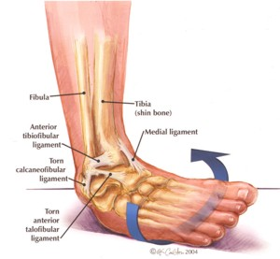
Functional contextual analysis
Decontextualised Mechanistic analysis

Slide 15
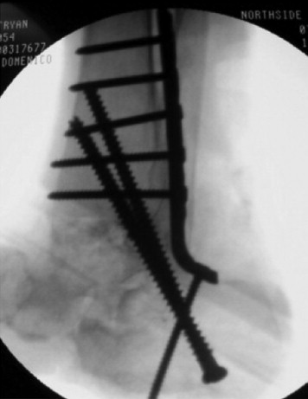

Functional contextual intervention
What’s true is what works… in relation to a specified direction or goal.
Mechanistic intervention
What’s true is what corresponds most closely to a measurable reality.

Slide 16
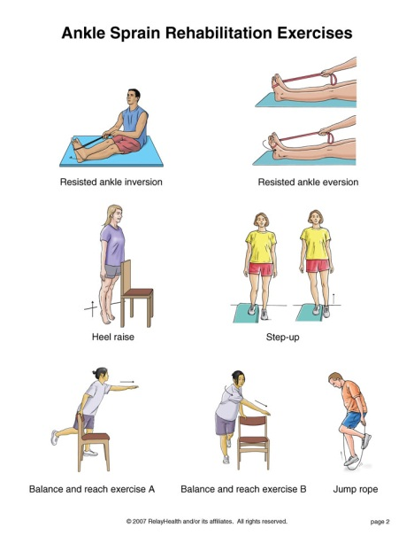
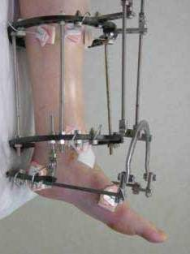
Functional contextual treatment
What’s true is what works…
  ...Towards valued living
DSM / syndromal treatment
Less difficult feelings and thoughts
Less items on checklists of troubles

Slide 17
Trends in psychotropic meds
in Australia: 2000 - 2011
Stephenson et al, Aust N Z J Psychiatry 9.11.2012
ANTIDEPRESSANTS DOUBLED
“ATYPICAL” ANTIPSYCHOTICS TRIPLED
ADHD MEDS DOUBLED
XANAX DOUBLED
LAMOTRIGINE DOUBLED
AND AUSTRALIAN’S MENTAL HEALTH?
NO IMPROVEMENT
Changes in psychological distress in Australian adults 1995 - 2011.
Jorm and Reavley, Aust N Z J Psychiatry 2012

Slide 18
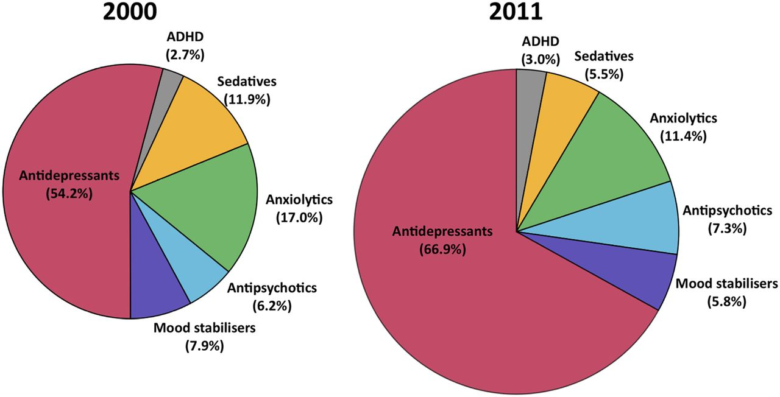
Trends in psychotropic meds in Australia 2000 to 2011
Figure 1. Share of market (DDD/1000 population/day) per class
Notes:
Pie charts showing the share of the market (in terms of DDD/1000 population/day) for each psychotropic class in 2000 and 2011. Note the 2011 figure is 58% larger in area to graphically represent the growth in the psychotropic drug market as a whole.

Slide 19
Functional contextual treatment
What’s true is what works…
  ...Towards valued living
DSM / syndromal treatment
Less difficult feelings and thoughts
Less items on checklists of troubles

Slide 20
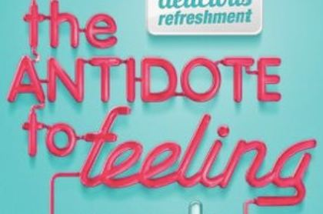
DSM depression … depressed mood most of the day
DSM anxiety - …excessive anxiety…

Slide 21
Emotional Side-effects of Antidepressants
Price J… Goodwin G. Journal of Affective Disorders 2012
www.whocaresinsweden.com
Because I don’t care so much, I’m having problems at home
I don’t have the same passion and enthusiasm for life
Other people being upset doesn’t affect me
Because I don’t care so much, I’m having problems at work or college
Day to day life doesn’t have the same emotional impact
I don’t react to other people’s emotions as much
I don’t care as much about my day to day responsibilities
I just don’t care about things as much as I did

Slide 22
Who Cares In Sweden? - documentary
Millions of Swedes are suffering because of the effects from certain types of antidepressants, the SSRIs.
The whole of society is affected by the antidepressant whose main effect is that you "care" less.
No one speaks today of the effect which is in fact a reduction in conscience and empathy.
A soldier with nightmares and guilt feelings takes the same medication as does a Swedish judge...
www.whocaresinsweden.com – the emotional and societal side-effects of SSRI and SNRI medications

Slide 23
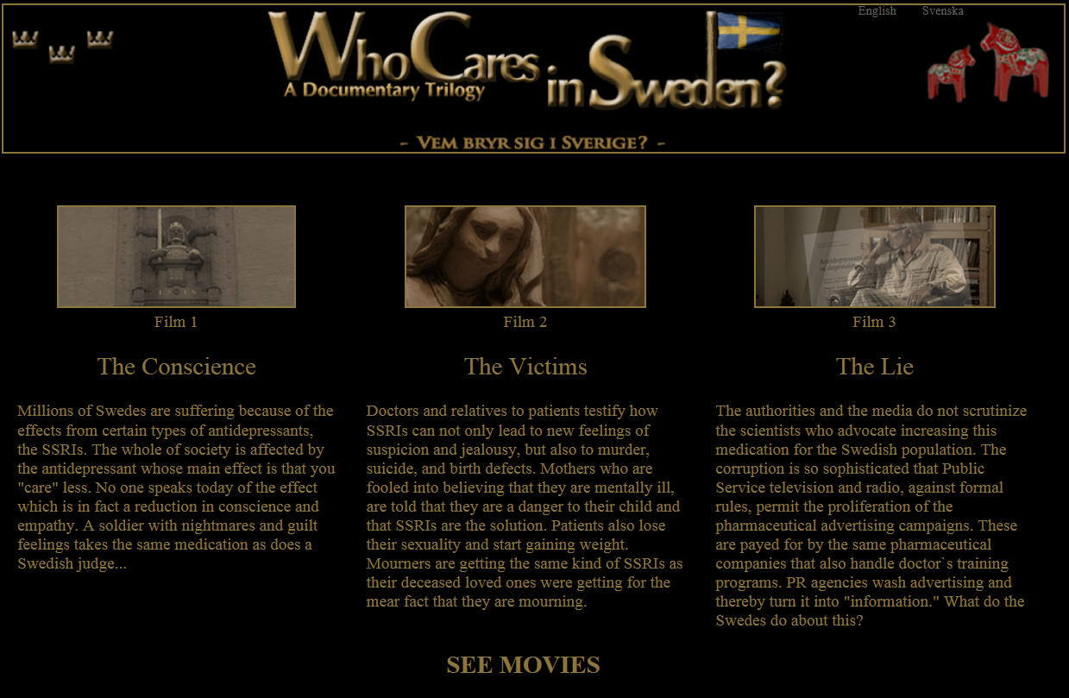

Slide 24
Data Based Medicine - health warning
Doctors most persuaded people on earth
Many resist company adverts / free lunches
Unaware that trials / guidelines are advertisements
“Independent” guidelines, Cochrane, NICE most dangerous
Guidance / awareness will shock many doctors
Clever marketing → many feel personally attacked
No-one should have to cope with present uncertainties
RxISK papers are disturbing – “think twice before reading”

Slide 25
Pharmageddon – David Healy 2012
Stockholm Syndrome:
Both sides are captive – the patients, “held by” actually kind doctors
Patient’s lives in hands of their treating doctors
These doctors are really nice and caring
Patients don’t wish to upset / speak poorly of their doctor / treatment → will not complain of side-effects, lack of efficacy
Both sides are captive – the doctors, “held by” seemingly kind Pharma
Doctor’s livelihood in hands of pharmacology companies (what is special, “valued added” re: a doctor? → their ability to prescribe
Pharma reps ARE really nice and apparently very caring
Doctors don’t wish to upset / speak poorly of the Pharmaceutical industry→ will not complain of side-effects, lack of efficacy

Slide 26
DBM Position Paper - Antidepressants
1000’s publications, over 1000 trials
50-­90% ghost-written – figures from court evidence
40‐50% of studies unpublished
30% of POSITIVE studies actually NEGATIVE
Risks are not published
www.rxisk.org – research papers

Slide 27
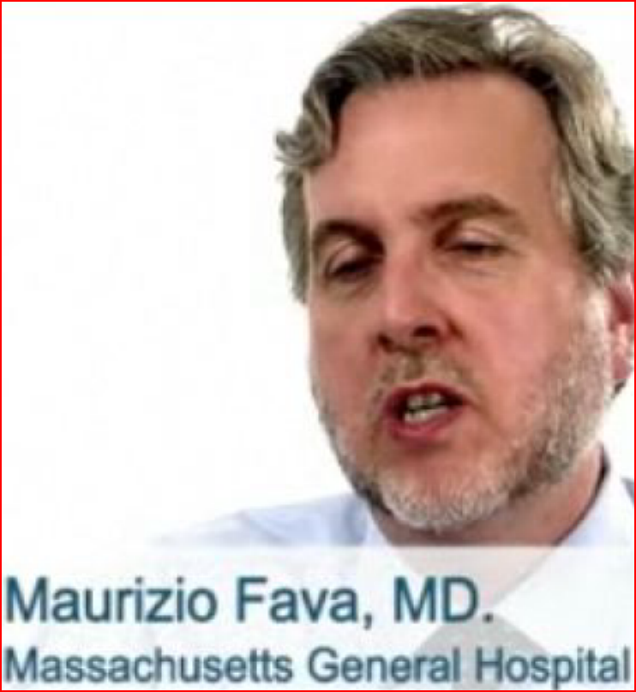
STAR D, NIMH published V real results
"The overall cumulative remission rate was 67%“
But closer review found…
4041 started, 108 remitted, the rest either relapsed and/or dropped out → remission rate 2.7%
“I think their analysis is reasonable and not incompatible with what we had reported“

Slide 28
DBM on Guidelines for Antidepressants
Published trials of “good quality”?
Almost all only a few weeks
No quality of life measures
Scales improve with side effects
RECOGNIZED GUIDELINES?
None score Quality Mark > 1 /10
Independent guidelines superior?
-> identical HENCE more dangerous
COCHRANE?
Sertraline
Antidepressants for children
Tamiflu

Slide 29
THERE IS NO CHEMICAL IMBALANCE
40 years of neurotransmitter theories – NO EVIDENCE
“NO serotonin or norepinephrine deficiency”
Professor of Neuroscience E.Valenstein
“…there is no “real” monoamine deficit”
Psychopharmacologist Stephen Stahl
“NO simple neurochemical explanations”
Professor Kenneth Kendler
“Antidepressants affect processes unrelated to the pathology of depression”
Krishnan and Nestler, AJP in press 2010

Slide 30
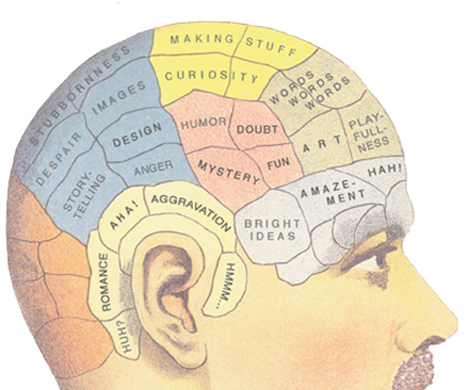
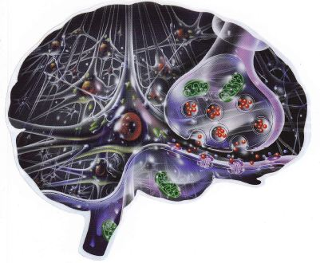
OLD and NEW BIOMYTHOLOGIES

Slide 31
Functional Contextual Therapy AND Pharmacology
• Not “FIXING” thoughts and feelings
… or chemistry and biology
Functional contextual view of behavior
… of biology
… of medications
Destructive normality

Slide 32
Flexible, pragmatic pharmacology
Let go of DSM
        except where necessary ☺
Drop “symptoms” … “illness”… “symptom removal”
→ esp “remission is the goal”
Frees from experiential struggle
→ overmedicating / chronicity
Meds “Toward valued living
                … edge off so as to do stuff”
Meds “Away from unwanted experiencing
              … ridding bad feelings / thoughts”

Slide 34
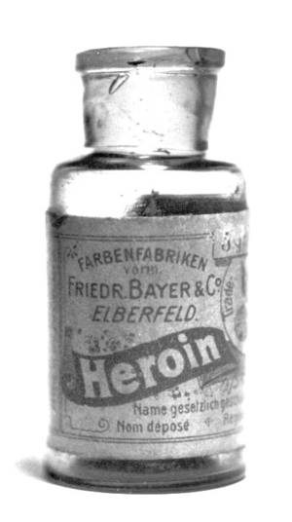
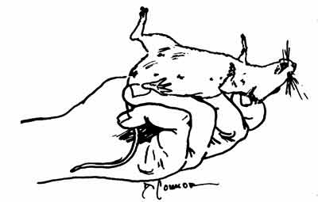

Context & heroin: rats
Lethality of heroin in 3 groups:
2 tolerant (colony VS white noise), 1 control
LETHAL DOSE GIVEN:
96% lethality - Control
64% lethality - NEW envt CF tolerance
32% lethality - SAME envt as tolerance

Slide 35
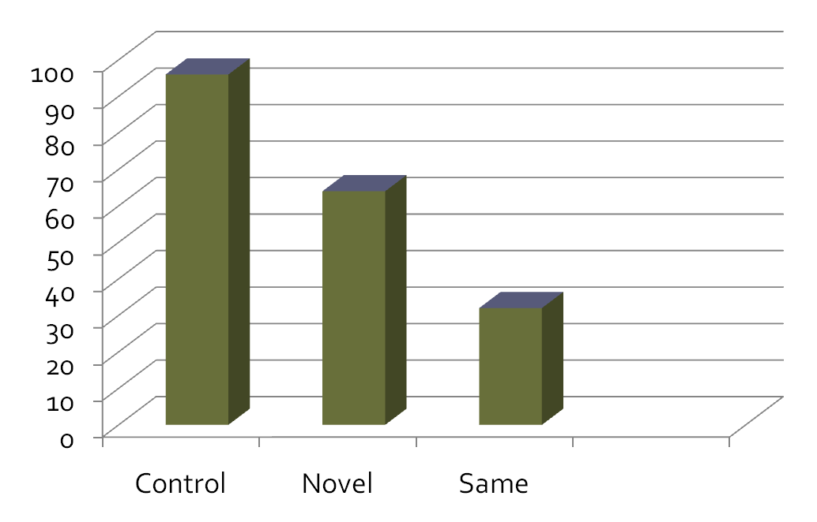
CONTEXT & heroin - rats & humans
Siegel et al. 1982 “Heroin ‘overdose’ death:
Contribution of drug-associated Environmental cues.” Science.

Slide 36
Situational Specificity of Tolerance
Overdose deaths in humans due to:
Opioids
Alcohol
Pentobarbital
Understanding / Preventing Overdoses clinically
→ … 3 human OD’s reflected this mechanism, as these patients normally did not inject on staircases / toilets
Deaths of heroin users in a general practice population. Bucknall and Robertson, J R Coll Gen Pract. 1986

Slide 37
MOVING TOWARDS WORKABLE MEDICATION USE - TOGETHER
What is important to you and your clients? How can medication knowledge and use might be helpful?
What medication-related issues get in the way for you and them?
What do you and your clients do to move Away from these medication-related issues?
Can Functional Contextual Pharmacology help?
What can we and our clients do to move Toward those things important to us and them? How can we use medication knowledge and use to help?
Notes:
For clinicians, these are perhaps the most immediately useful applications of this material.

Slide 39
4. What can we and our clients do to move Toward those things important to us and them? How can we use medication knowledge / use to help?
Use medications to move towards i.e. Link meds to improvement in function Call them “performance enhancing drugs” Reframe - pain is not a panadol imbalance Listen to user experience Defuse from anti-Pharma prejudice N = 1 studies can be very meaningful data Challenge / dechallenge / rechallenge IS solid empirical N=1 data Flexible non-challenging languaging Empower clients to find drug information Encourage clients to speak to prescribers have clients take rxisk.org reports SSRI / SNRI = emotional tranquillisers Using an emotional cushion short term Antipsychotics = major tranquillisers | Take older drugs, newer are NOT better Educate doctors on what CBS has to offer Give doctors ACT / etc success stories Share behavioral research, outcome data Form networks and hasten slowly Join Healthy Skepticism www.healthyskepticism.org www.rxisk.org and also www.madinamerica.com Anatomy of an Epidemic. Pharmageddon Introduction to Behavioral Pharmacology www.rxlist.com see the USER’S REVIEWS www.whocaresinsweden.com Wikipedia is surprisingly good on drugs Remain optimistic!!! Benzodiazepines = minor tranquillisers

Slide 40
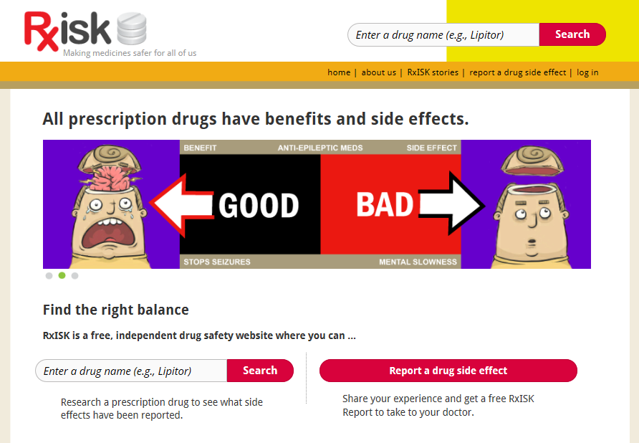


Slide 41
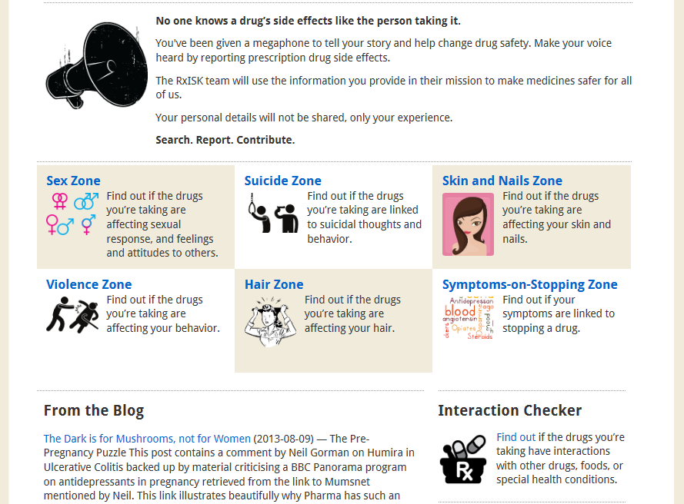

Slide 42
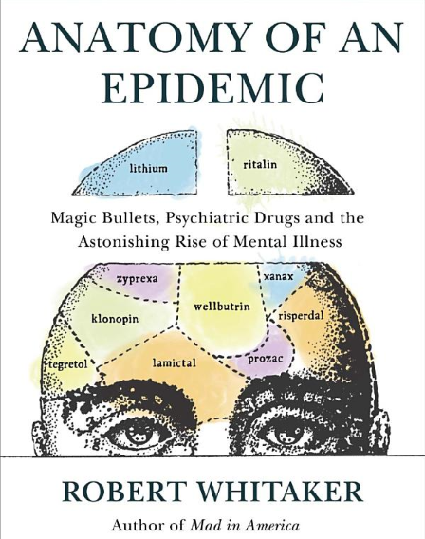
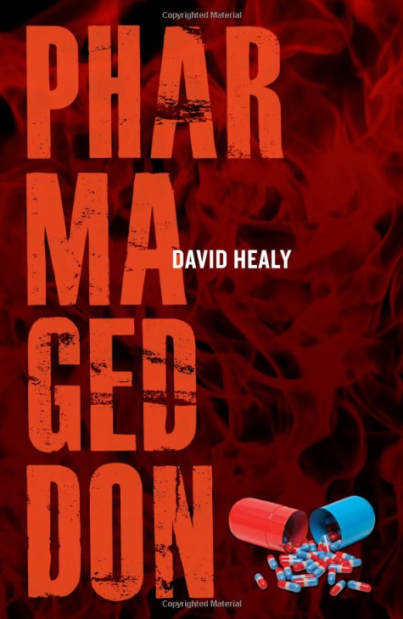

Slide 43
Healthy Skepticism – advocacy group
What? Improving health by reducing harm from misleading health information. Go to www.healthyskepticism.org
Why? misleading health information harms health and wastes resources.
Who? 219 members who live in 31 countries. Many health professionals but everyone welcome if they support our aims. This includes general public (patients, consumers). 9854 subscribers who live in 215 countries.
Where? Mostly this website and email groups but we also have some meetings in person at many locations around the world.
How? We share information via our website, forums, email discussion lists, academic journal publications and informing the media. Members may join task groups.
When? Since 1983. Go to www.healthyskepticism.org

Slide 44
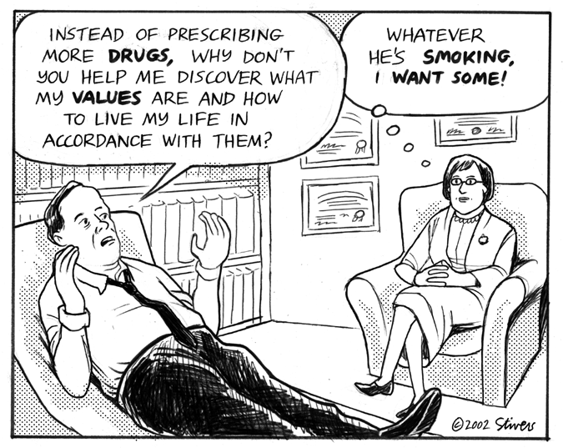

Slide 45
ACT on Drugs 2011 - the theory in detail
Functional Contextual Pharmacology
3 hour detailed workshop, contrasting with the mainstream
ANZACT 2011: "ACT on Drugs: Functional Contextual Pharmacology“
First part - http://mediasite.qut.edu.au/mediasite/Viewer/?peid=f5a7d1a8-690a-4c7d-933e-f327e102c1a5
Second part - http://mediasite.qut.edu.au/mediasite/Viewer/?peid=93917b14-7588-4e98-acc9-9d43a5afdc75
ANZACT 2011: "Functional Contextualism- History, and FC Neuroscience" –this lecture gives detailed philosophy of science background to the above - see also chapter 4 of Advances in RFT book http://mediasite.qut.edu.au/mediasite/Viewer/?peid=3dbc2eb2-b12a-4d66-9ef6-30d1102c77e2

Slide 46
4. What can we and our clients do to move Toward those things important to us and them? How can we use medication knowledge / use to help?
Use medications to move towards i.e. Link meds to improvement in function Call them “performance enhancing drugs” Reframe - pain is not a panadol imbalance Listen to user experience Defuse from anti-Pharma prejudice N = 1 studies can be very meaningful data Challenge / dechallenge / rechallenge IS solid empirical N=1 data Flexible non-challenging languaging Empower clients to find drug information Encourage clients to speak to prescribers have clients take rxisk.org reports SSRI / SNRI = emotional tranquillisers Using an emotional cushion short term Antipsychotics = major tranquillisers | Take older drugs, newer are NOT better Educate doctors on what CBS has to offer Give doctors ACT / etc success stories Share behavioral research, outcome data Form networks and hasten slowly Join Healthy Skepticism www.healthyskepticism.org www.rxisk.org and also www.madinamerica.com Anatomy of an Epidemic. Pharmageddon Introduction to Behavioral Pharmacology www.rxlist.com see the USER’S REVIEWS www.whocaresinsweden.com Wikipedia is surprisingly good on drugs Remain optimistic!!! Benzodiazepines = minor tranquillisers

Slide 47
ACT on Drugs Resources
Functional Contextual Pharmacology
www.rxisk.org join, use Research Papers at bottom of site
ACT on Drugs 2011 – for more detailed theory and history of behavioral pharmacology see the Mediasite links in these slides
Contextual Medicine SIG via ACBS site
Healthy Skepticism – JOIN! and contribute (.org)
Anatomy of an Epidemic, and madinamerica.com
Pharmageddon, and David Healy.org
alltrials.net + google “RIAT BMJ” – support both
Who Cares In Sweden, superb documentary and re: cholesterol Statin Nation good documentary and site

